Slide 1

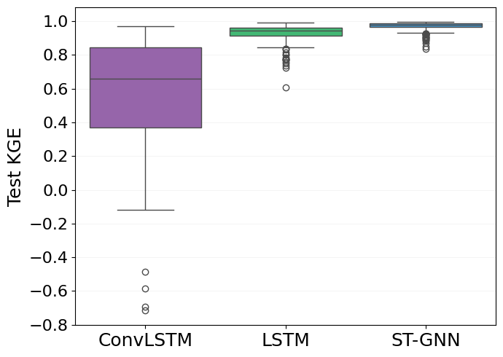
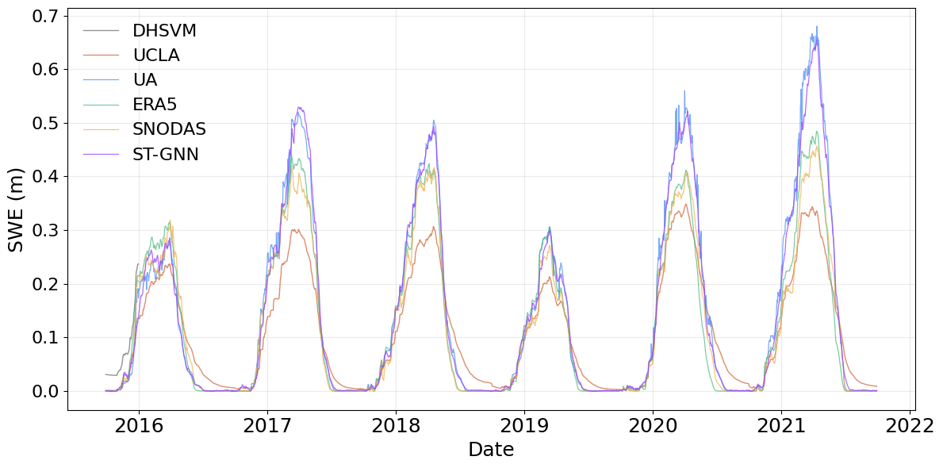

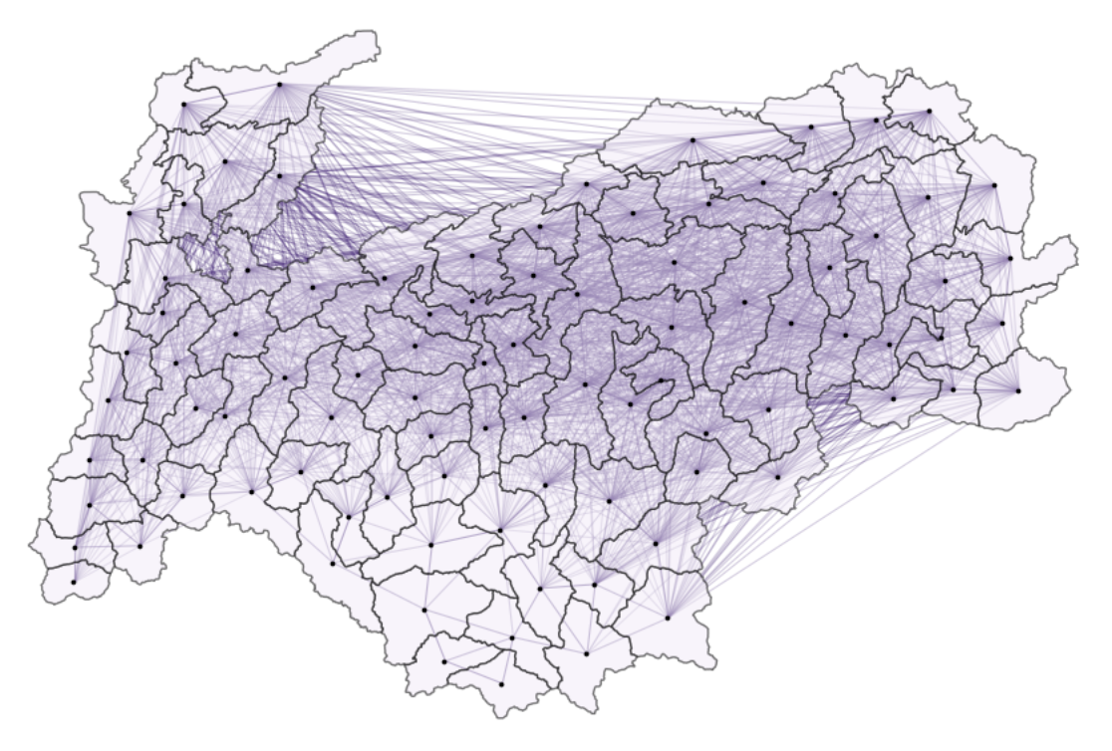
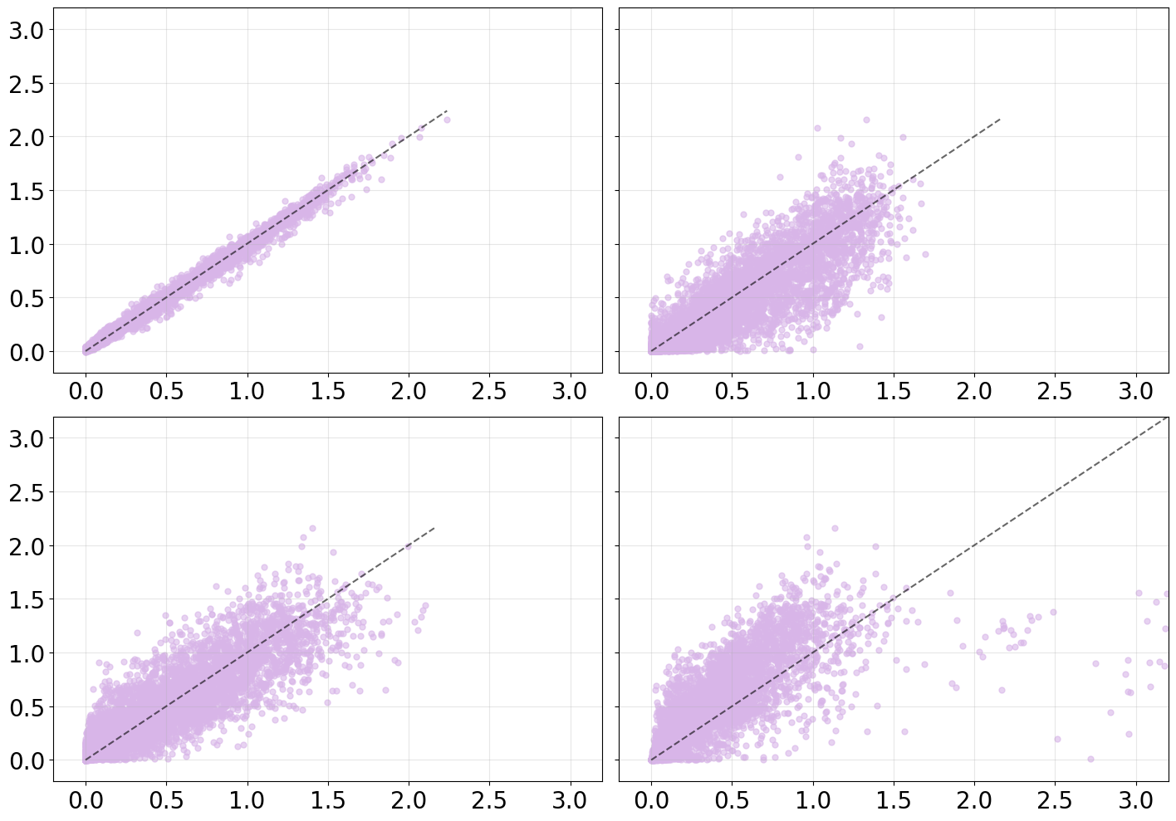
Mapping the Melt : Spatio-Temporal Learning for Snow Water Equivalent
Capstone Sponsor: Dr. Nicoleta Cristea
MSDS Team: Arjita Nema, Reddy Khaja Valluru, Ridhi Jain, Riyosha Sharma
Snowpack - A Water Reservoir
Daily SWE is modeled across 626 HUC-12 watersheds spanning 20 sub-basins in the PNW using a Spatio-Temporal Graph Neural Network. Each watershed is represented as a node in a geographic adjacency graph, with temporal dynamics learned from 40 years of SWE data, meteorological variables, and watershed attributes.
TEST KGE | MEAN | MEDIAN | INTERQUARTILE RANGE
LSTM | 0.789 | 0.821 | ( 0.707 - 0.883 )
ST-GNN | 0.761 | 0.962 | ( 0.845 - 0.982 )
Seasonal snowpack acts as a natural water reservoir in the PNW. SWE measures the amount of water stored in snow and is critical for water supply forecasting. Understanding and accurately modeling SWE dynamics across watersheds remains a key challenge in hydrological prediction.
ST-GNN Input Feature Selection
Spatial Context Improves SWE Approximation!
LSTM and ST-GNN model performance across HUC-12 watersheds in the PNW region.
Meteorological features
Snow state indicators
Watershed characteristics
Seasonal climate indicators
SWE Dynamics Across Data Products
Spatio-Temporal SWE Prediction
Can spatio-temporal deep learning models outperform temporal only models in approximating physics-based SWE estimates across PNW watersheds?
Sequential Floating Feature Selection
MODELS EVALUATED
ST-GNN
ConvLSTM
Time series comparison of SWE estimates in the Snohomish Basin across multiple SWE data products. ST-GNN predictions closely track SWE patterns across datasets, capturing key regional snow dynamics in the PNW.
Static features | Dynamic features
Mean Elevation | Mean Precipitation Mean Temperature SWE lag-7
Test KGE distribution across HUC-12 montane and maritime watersheds comparing the three models. ConvLSTM shows greater variability in performance, while ST-GNN achieves higher KGE than LSTM across watersheds.
Glossary
SWE (Snow Water Equivalent) – Amount of water stored in snowpack
PNW - Pacific Northwest
HUC (Hydrologic Unit Code) – Watersheds classification system
ST-GNN – Spatio-Temporal Graph Neural Network
ConvLSTM – Convolutional Long Short-Term Memory
KGE (Kling-Gupta Efficiency) – Metric for hydrological model performance
Peak SWE : ST-GNN vs. Other products
Reference SWE Data Products
UA
ERA5
DATASET | TYPE | METHODOLOGY
UA SWE | Reconstruction | Satellite snow cover + meteorological data
UCLA SWE | Reanalysis | Model + MODIS/Landsat snow observations
SNODAS | Operational model | Physics-based snow model with data assimilation
ERA5- Land | Global reanalysis | Land surface model forced by atmospheric data
DHSVM | Hydrologic model | Physics-based watershed snow simulation
Predicted SWE (ST-GNN)
SNODAS
UCLA
Acknowledgements
We sincerely thank our capstone sponsor, Dr. Nicoleta Cristea, and capstone director, Dr. Megan Hazen, for their guidance, leadership, and invaluable support throughout this project. We also extend our gratitude to the eScience Institute and the UW MSDS program for their support and resources that made this work possible.
Adjacency matrix with HUC-12s as nodes and edges defined by shared perimeter and proximity. Each node stores both static and dynamic features.
April 1 SWE is widely used to estimate winter snowpack water and guide water allocation decisions in the western United States. ST-GNN predictions closely match observed peak SWE across multiple SWE data products.

